Slide 1














“Optimizing Legal Document Generation: A Fine-Tuned Llama-2 Model with Customized Legal Data”
Presented by Team 11A

Slide 2

LLaMA Model Overview
1. LLaMA (Large Language Model Meta AI):
- Autoregressive Language Models by Meta AI since February 2023.
- Model Sizes: 7B, 13B, 33B, 65B parameters.
- 13B model excels in NLP benchmarks.
2. Accessibility and Licensing:
- Open access to model weights under a noncommercial license.
- Enables community-driven research beyond limited APIs.
3. Utilization in Text Generation:
- Adopted meta-llama/Llama-2-7b-chat-hf model from Hugging Face.
- Selected for compatibility and excellence in legal text generation.

Slide 3
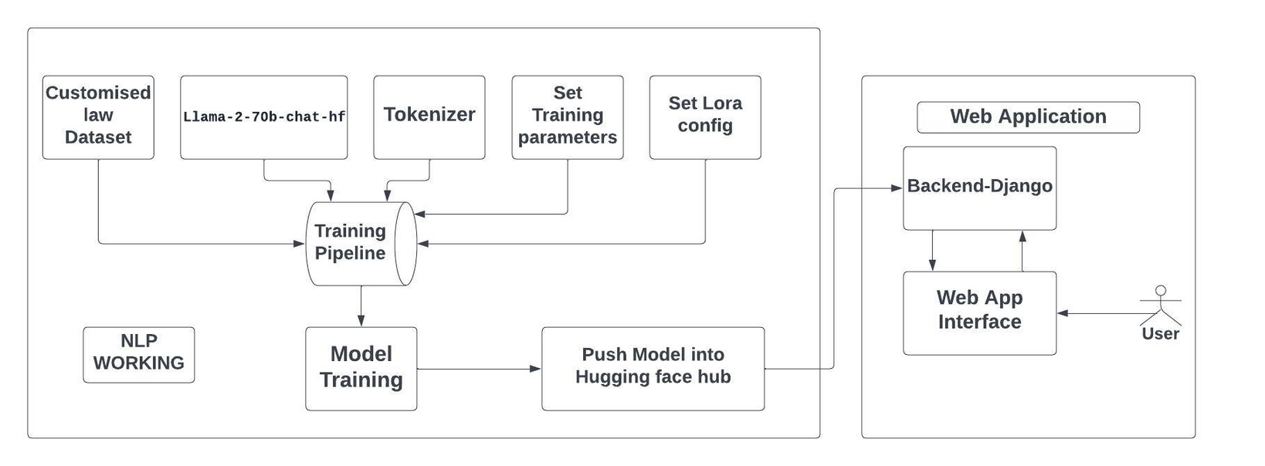
Ideation process
01
02
03
04
05
06
07
Prepare
Custom law data set
Set Lora Parameters
Set training Parameters
Train the model
Push the model into hugging face
web app using django framework
Define model and Tokenizer

Slide 4
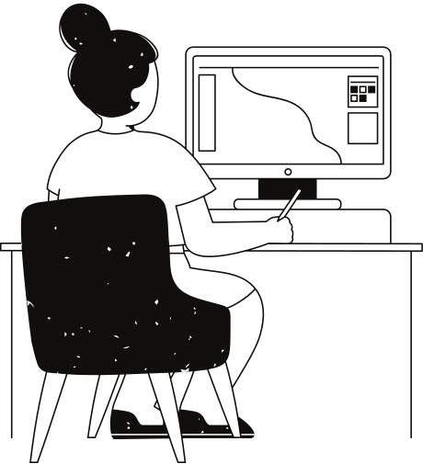
Base Model and Tokenizer
Base Model Selection:
We started with a robust foundation, leveraging the meta-llama/Llama-2-7b-chat-hf model from the Hugging Face Transformers repository.
The choice was driven by the model's architecture, pre-training on extensive datasets, and its adaptability to dialogue-based applications.
Tokenizer Overview:
The tokenizer, an integral component, plays a key role in processing and preparing textual data for the language model.
We utilized the AutoTokenizer from the Hugging Face Transformers library, ensuring seamless integration with the chosen base model.

Slide 5

Dataset Utilization
Dataset Selection:
Leveraged the "Indian Lawyer Dataset" from GitHub and Hugging Face, ensuring a diverse and representative sample for legal text generation.
Significance of Dataset:
Valuable resource with real-world legal examples, enhancing the model's understanding of nuanced language in diverse legal scenarios.
Training Data Processing:
Rigorous preprocessing maintained data quality, contributing to the model's proficiency in generating contextually relevant legal text.

Slide 6

LoRA and Training Parameters
LoRA Parameter Setup (LoRA):
Quantized LoRA (LoRA) Configuration:
Alpha (Scaling Parameter): 16
Dropout Probability: 0.1
Attention Dimension (r): 64
Bias: None
Task Type: CAUSAL_LM
Training Parameters:
Model Training Configuration:
Output Directory: "./results"
Number of Training Epochs: 1
Batch Size: 4 per device
Optimizer: paged_adamw_32bit
Learning Rate: 2e-4
Gradient Accumulation Steps: 1
Weight Decay: 0.001
Enhancing Model Performance:
Carefully tuned LoRA parameters and training configurations ensure optimal performance during the fine-tuning process, contributing to the model's proficiency in legal text generation.

Slide 7


Training and Hugging Face Integration
1. Training Process:
- Model optimization with QLoRA and LoraConfig.
- Fine-tuned on "Indian Lawyer Dataset" for domain expertise.
- Leveraged LLaMA from Hugging Face for effective dialogue applications.
2. Hugging Face Integration:
- Model saved as "Llama-2-7b-indian_lawyer_chat-finetune."
- Seamless integration with Hugging Face Transformers ecosystem.
- Wider accessibility within the developer community.
3. Contributing to Hugging Face Hub:
- Model contributions to Hugging Face Hub for shared knowledge and advancements in legal text generation.

Slide 8
Web Application Overview
1. Frontend Development
- Developed an intuitive and user-friendly web interface using HTML, CSS, and JavaScript.
- Ensured seamless user experience in legal text generation scenarios.
- Designed with accessibility and ease of use as primary considerations.
2. Backend Framework: Django
- Backend powered by Django framework for robust and scalable performance.
- Facilitates efficient data handling and model interactions.
- Django's versatility supports seamless integration with various components.

Slide 9

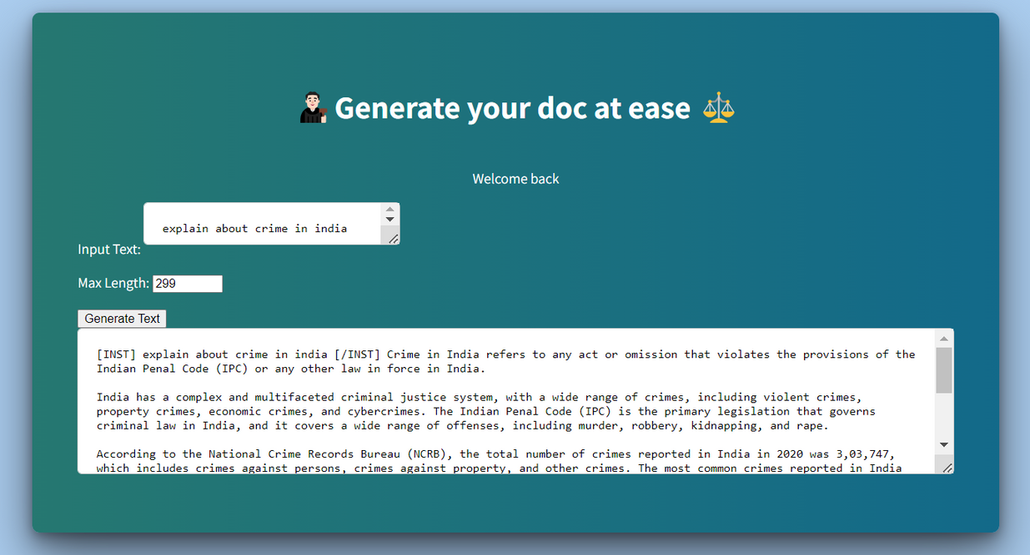
Interface

Slide 10
Thank you very much!
Chandana Badugu(20PA1A0525)
Guduru Mukesh Krishna (20PA1A0555)
Avvari Chanikya Vardhan (20PA1A0513) Devarapalli Vanesh (21PA5A0502)

